Slide 1
ELK Overview
Presentation Subtitle Arial Regular 20/24pt

Slide 2
Log Analysis
Introduction to ELK
Elasticsearch
Logstash
Kibana
Beats
Log Format Pattern
Exercise

Slide 3
Log Analysis

Slide 4
What is Log Analysis
Log Analysis is the process of analyzing the computer / machine generated data for
Issue Debugging
Security Analysis
Internet of Things & Debugging
Predictive Analysis
Performance Analysis

Slide 5
Problems With Log Analysis
Non-consistent log format
Non-consistent time format
Decentralized logs
Expert knowledge requirement

Slide 6
Introduction to ELK

Slide 7
What is ELK?
The ELK Stack was a collection of three open-source products — Elasticsearch, Logstash, and Kibana — all developed, managed and maintained by Elastic. The introduction and subsequent addition of Beats turned the stack into a four legged project and led to a renaming of the stack as the Elastic Stack.

Slide 8
What is ELK?
Elasticsearch is an open source, full-text search and analysis engine
Logstash is a log aggregator that collects data from various input sources then ships the data to various supported output destinations
Kibana is a visualization layer that works on top of Elasticsearch, providing users with the ability to analyze and visualize the data
Beats are lightweight agents that are installed on edge hosts to collect different types of data for forwarding into the stack

Slide 9
Why is ELK so popular?
It fulfills a need in the log management and analytics space
A powerful platform that
collects and processes data from multiple data sources
stores that data in one centralized data store
provides a set of tools to analyze the data
Fits into modern architecture like microservices, containers

Slide 10
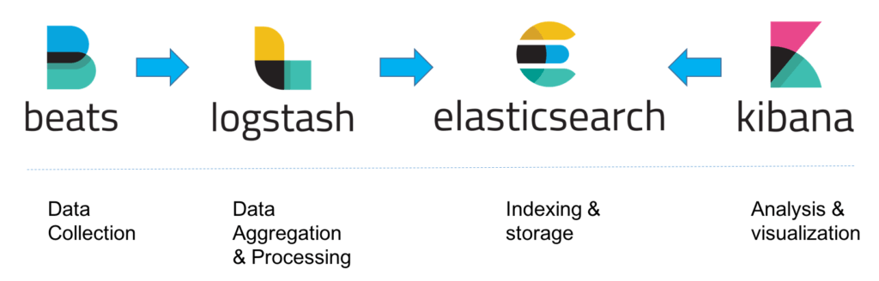
Classic Architecture for ELK Stack

Slide 11
Modern Log Management Keys
Aggregation – the ability to collect and ship logs from multiple data sources.
Processing – the ability to transform log messages into meaningful data for easier analysis
Storage – the ability to store data for extended time periods to allow for monitoring, trend analysis, and security use cases
Analysis – the ability to dissect the data by querying it and creating visualizations and dashboards on top of it

Slide 12
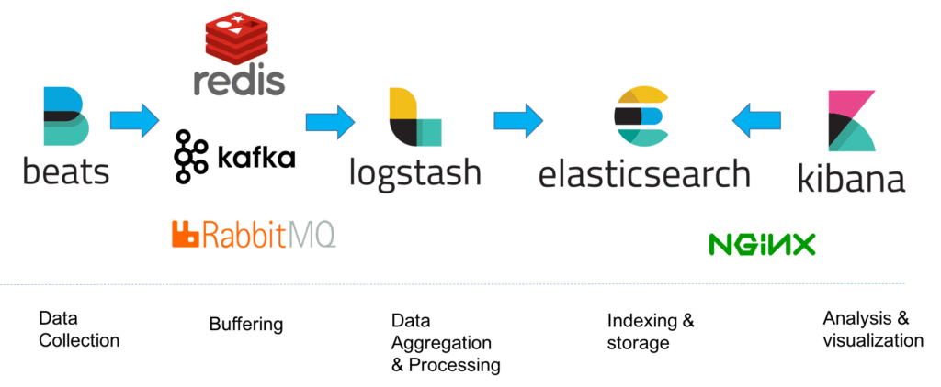
Sample Architecture for ELK Stack

Slide 13
Elasticsearch

Slide 14
What is Elasticsearch?
A modern search and analytics engine which is based on Apache Lucene
NoSQL database which stores data in an unstructured way
Allow using SQL statements to interact with the data
Strong focus on search capabilities and features
REST API for full extensive search features

Slide 15
Basic Elasticsearch Concepts
Index
Similar to Index in Relational Database
Logical partitions of documents, similar to those of a relational database
You can have as many indices as you want but this can affect performance
Identified by lowercase names
Documents
Similar to row in Relational Database
Base unit of storage
JSON objects that are stored within an Elasticsearch index
Data defined with fields comprised of keys and values
Contain reserved fields that store the document metadata such as _index, _type and _id

Slide 16
Basic Elasticsearch Concepts
Types
Subdivide similar types of data wherein each type represents a unique class of documents
Consist of a name and a mapping
No longer be supported starting in version 8.x
Mapping
Similar to schema in Relational Database
Defines the fields for documents of a specific data type
Can be defined explicitly or generated automatically when a document is indexed using templates

Slide 17
Basic Elasticsearch Concepts
Shards
Index size is a common cause of Elasticsearch crashes
Indices being split up horizontally into pieces to shards
Distribute operations across shards and nodes to improve performance
Replicas
Easily recover from system failures such as unexpected downtime
Make copies of shards called replicas
High availability

Slide 18
Elasticsearch Queries
Boolean Operators
AND, OR, NOT
tom OR jerry
Fields
looking for events where a specific field contains certain terms
name:”Ned Stark”
Ranges
search for fields within a specific range
square brackets ([]) for inclusive range searches and curly braces ({}) for exclusive range searches
age:[3 TO 10]

Slide 19
Elasticsearch Queries
Wildcards, Regexes and Fuzzy Searching
* character for multiple character wildcards
? character for single character wildcards
URI Search
using the q query parameter
curl “localhost:9200/_search?q=name:john~1 AND (age:[30 TO 40} OR surname:K*) AND -city”

Slide 20
Elasticsearch REST API
Document API
handling documents in Elasticsearch
create, update, move or remove document from index
Search API
query indexed data for specific information
Indices API
manage indices, mappings, and templates
create or delete a new index
check if a specific index exists or not
Cluster API
manage and monitor Elasticsearch cluster

Slide 21
Logstash

Slide 22
What is Logstash?
Processing the log messages, enhancing them and massaging them and then dispatching them to a defined destination for storage
Can be used to collect, enrich and transform a wide array of different data types using plugins

Slide 23
Logstash Configuration
Which data is collected, how it is processed and where it is sent to, is defined in a Logstash configuration file that defines the pipeline
Each of these stages is defined in the Logstash configuration file with what are called plugins
Input plugins for the data collection and aggregation stage
e.g. file, beats, syslog, http, tcp, udp, stdin
Filter plugins for the processing, manipulation stage
e.g. grok, date, mutate, drop
Output plugins for the dispatching stage
Support codecs that allow you to encode or decode your data

Slide 24
Logstash Configuration - Example
Input
input {
file {
path => "/var/log/apache/access.log"
start_position => "beginning"
}
}
Filter
filter {
grok {
match => { "message" => "%{COMBINEDAPACHELOG}" }
}
date {
match => [ "timestamp" , "dd/MMM/yyyy:HH:mm:ss Z" ]
}
geoip {
source => "clientip"
}
}

Slide 25
Logstash Configuration - Example
Output
output {
elasticsearch {
hosts => ["localhost:9200"]
}
}

Slide 26
Kibana

Slide 27
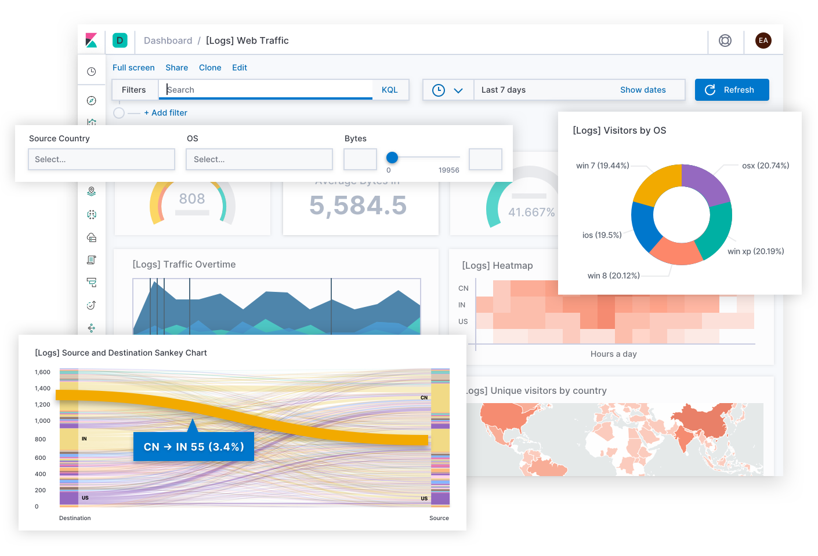
What is Kibana?
A powerful analysis and visualization layer on top Elasticsearch and Logstash
It is a browser-based user interface that can be used to search, analyze and visualize the data stored in Elasticsearch indices

Slide 28
What is Kibana?
Kibana Searches
Kibana querying is an art unto itself, and there are various methods you can use to perform searches on your data. Here are some of the most common search types
Free text searches – used for quickly searching for a specific string.
Field-level searches – used for searching for a string within a specific field.
Logical statements – used to combine searches into a logical statement.
Proximity searches – used for searching terms within a specific character proximity.

Slide 29
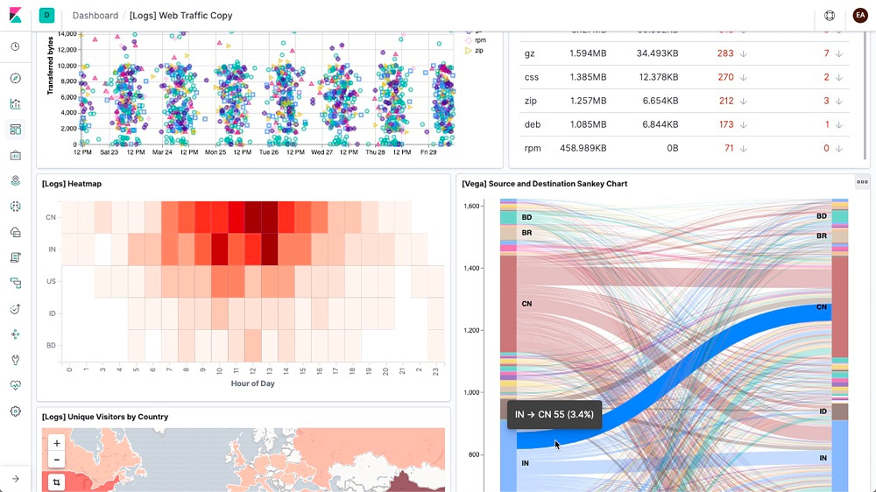
What is Kibana?
Kibana ships with classics:
Histograms
Line graphs
Pie Charts
Sunburts and more

Slide 30
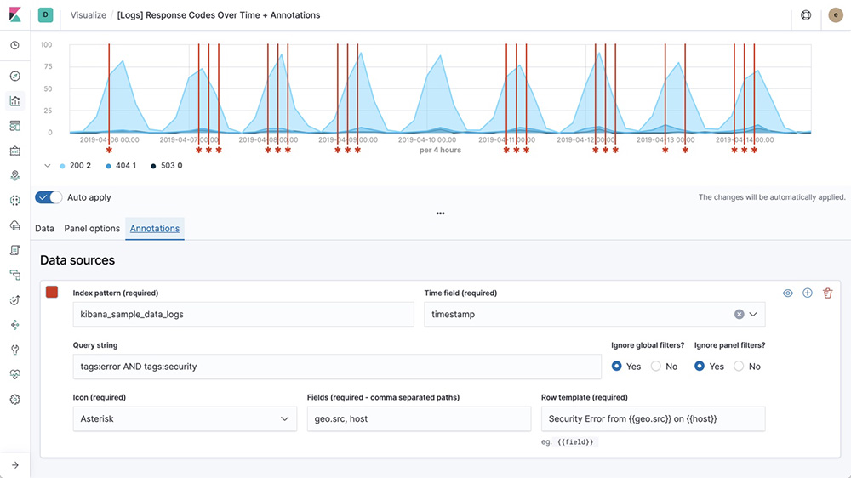
What is Kibana?
Time Series
Perform advanced time series analysis on your Elasticsearch data with our curated time series UIs. Describe queries, transformations, and visualizations with powerful, easy-to-learn expressions.

Slide 31
What is Kibana?
Kibana Lens
Drag and drop fields, and see immediate previews as your data takes shape.
Based on your field selection, smart suggestions in Kibana Lens guide you towards visualizations that most effectively communicate your data. Spot an interesting trend that spurs another idea

Slide 32
Beats

Slide 33
What is Beats?
Beats are a collection of open source log shippers that act as agents installed on the different servers in your environment for collecting logs or metrics. Written in Go, these shippers were designed to be lightweight in nature — they leave a small installation footprint, are resource efficient, and function with no dependencies.

Slide 34
What is Beats?
Different type of beats
Filebeat
Filebeat is used for collecting and shipping log files. Filebeat can be installed on almost any operating system, including as a Docker container, and also comes with internal modules for specific platforms such as Apache, MySQL, Docker and more, containing default configurations and Kibana objects for these platforms.

Slide 35
What is Beats?
Different type of beats
Packetbeat
A network packet analyzer, Packetbeat was the first beat introduced. Packetbeat captures network traffic between servers, and as such can be used for application and performance monitoring. Packetbeat can be installed on the server being monitored or on its own dedicated server.
Metricbeat – system and services metrics
Winlogbeat – Windows event logs

Slide 36
What is Beats?
Different type of beats
Metricbeat
Metricbeat collects ships various system-level metrics for various systems and platforms. Like Filebeat, Metricbeat also supports internal modules for collecting statistics from specific platforms. You can configure the frequency by which Metricbeat collects the metrics and what specific metrics to collect using these modules and sub-settings called metricsets. Metricbeat – system and services metrics

Slide 37
What is Beats?
Different type of beats
Winlogbeat
Winlogbeat will only interest Windows sysadmins or engineers as it is a beat designed specifically for collecting Windows Event logs. It can be used to analyze security events, updates installed, and so forth.

Slide 38
What is Beats?
Different type of beats
Auditbeat
Auditbeat can be used for auditing user and process activity on your Linux servers. Similar to other traditional system auditing tools (systemd, auditd), Auditbeat can be used to identify security breaches — file changes, configuration changes, malicious behavior, etc.

Slide 39
What is Beats?
Different type of beats
Functionbeat
Functionbeat is defined as a “serverless” shipper that can be deployed as a function to collect and ship data into the ELK Stack. Designed for monitoring cloud environments, Functionbeat is currently tailored for Amazon setups and can be deployed as an Amazon Lambda function to collect data from Amazon CloudWatch, Kinesis and SQS.

Slide 40
LOG Format Pattern

Slide 41
Log Format Pattern
A proper log message format is very import to for us to perform troubleshooting. Here are the key elements we must include in the API log message
Correlation ID. An unique ID able to link up all end to end service requests
Date and time. It doesn't have to be UTC as long as the timezone is the same for everyone that needs to look at the logs.
The service name or code, so that you can differentiate which logs are from which microservice.
The function, class, or file name where the error occurred so that you don't have to guess where the problem is.
User-agent of the application so that you know which browsers or users are having issues.
External service interaction names-you'll know which call to the DB was the one with the problem.
The IP address of the server and client request. This information will make it easy to spot an unhealthy server or identify a DDoS attack.
HTTP code to get more semantics of the error. These codes will be useful to create alerts.
Stack errors. You could pass the exception object as a parameter to the logging library.

Slide 42
Log Format Pattern
Sample Log Pattern
Suggest to use JSON as the structure of the log message
Correlation ID. An unique ID able to link up all end to end service requests
Date and time. It doesn't have to be UTC as long as the timezone is the same for everyone that needs to look at the logs.
The service name or code, so that you can differentiate which logs are from which microservice.
The function, class, or file name where the error occurred so that you don't have to guess where the problem is.
Log Level. Indicate the logging level such as warn, info, error, debug.
User-agent of the application so that you know which browsers or users are having issues.
External service interaction names-you'll know which call to the DB was the one with the problem.
The IP address of the server and client request. This information will make it easy to spot an unhealthy server or identify a DDoS attack.
HTTP code to get more semantics of the error. These codes will be useful to create alerts.
Stack errors. You could pass the exception object as a parameter to the logging library.

Slide 43
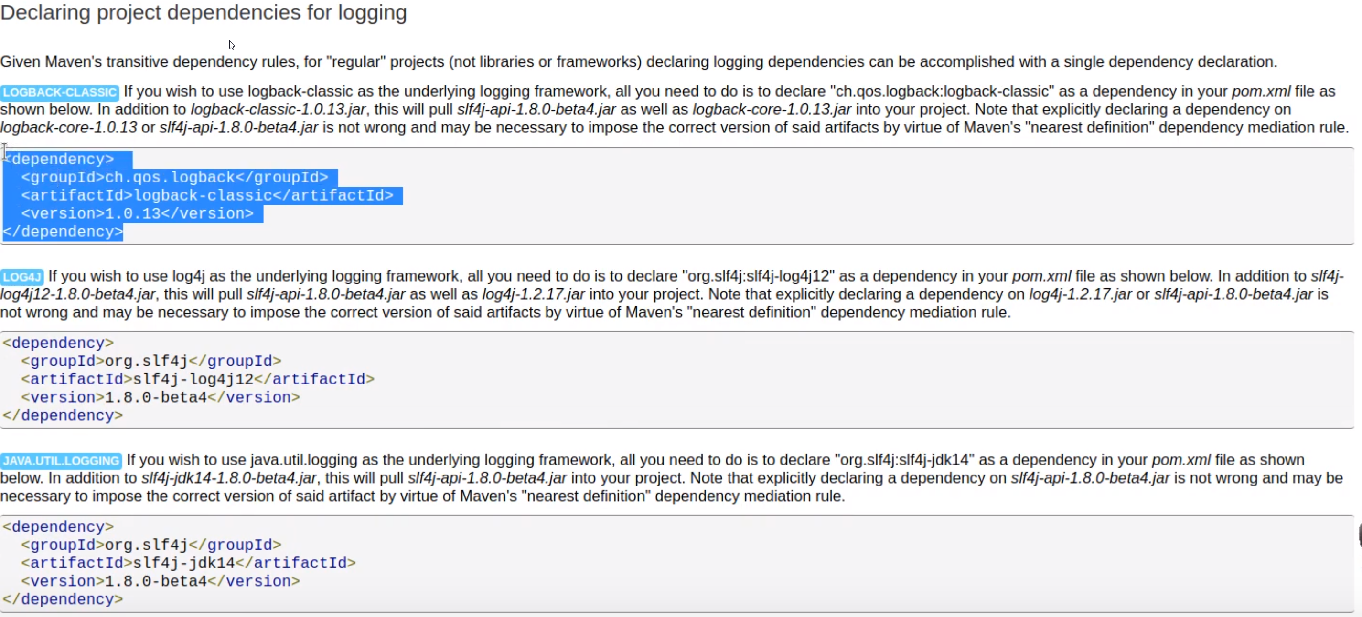
Log Format Pattern
Sample Code

Slide 44
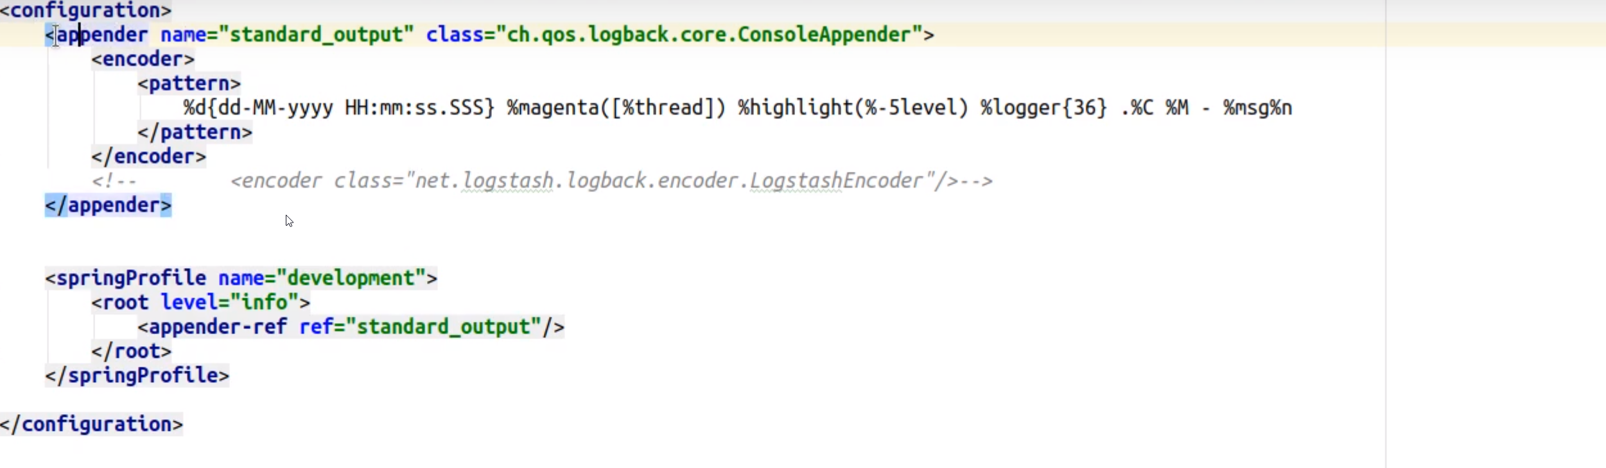
Log Format Pattern
Log configuration

Slide 45
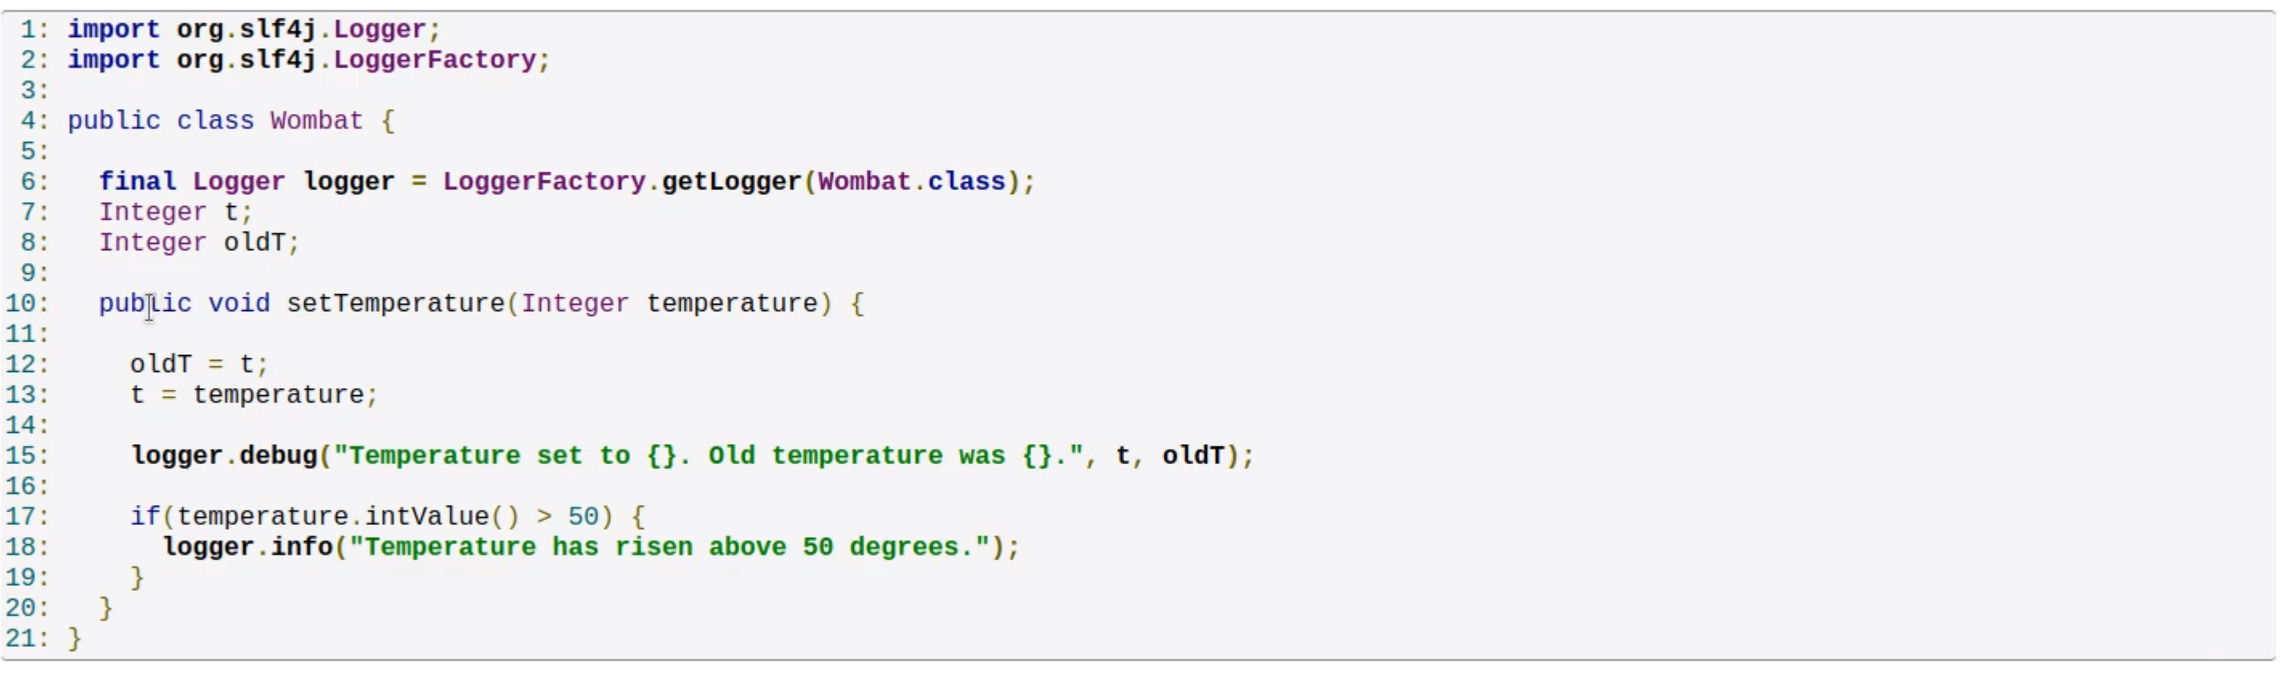
Log Format Pattern
Sample Code

Slide 46
SPLUNK

Slide 47
What is Splunk?
Known as the "Google for logfiles," Splunk is also marketed as a Security Information and Event Management (SIEM) solution, on top of being a log management and analysis platform.
The platform uses a proprietary search language called Search Processing Language (SPL) for traversing and executing contextual queries large data sets.

Slide 48
What is Splunk?

